Slide 1
Search Methods
Search can be characterized as finding a path through a graph or tree structure
This requires moving from node to node after successively expanding & generating connected nodes.
The process of generating all of the children of a parent is also known as expanding the node
A search procedure is a strategy for selecting the order in which nodes are generated & a given path selected
Search problems can be classified by the information used to carry out a given strategy
blind or uninformed search
informed or directed search

Slide 2
Search Strategies
A strategy is defined by picking the order of node expansion
Strategies are evaluated along the following dimensions:
Completeness: does it always find a solution, if one exists?
Time complexity: number of nodes generated/expanded
Space complexity: maximum number of nodes in memory
Optimality: does it always find a least-cost solution?
Time and space complexity are measured in terms of
b - maximum branching factor of the search tree
d - depth of the least-cost solution
m - maximum depth of the state space (may be ∞)

Slide 3
Uninformed or Blind Search
Breadth-first search
Uniform-cost search
Depth-first search
Depth-limited search
Iterative deepening search

Slide 4
Breadth – first Search (BFS)
Algorithm
begin
put start node in OPEN, found = false;
while OPEN not empty & not(found) do
begin
remove top-most node n from OPEN & put n in CLOSED;
expand n generating all its successors;
put those successors (in no particular order) at the end of OPEN except the
successor already appearing in OPEN or CLOSED; // can happen for graphs
direct backward pointer to n for each successor n_{i};
if any of the successor is a goal node then
found = true;
else if any of n_{i} is a dead end then
remove it from OPEN ;
end
if OPEN is empty then
output failure message;
else
output solution path by tracing back thru pointers;
end

Slide 5
Breadth – first Search (BFS) Example
S
m1 m2
m3
m4 m5
m6 r m3 m6
m1 m4 r
S
m2 m5
OPEN | CLOSED
S
S | S
m1m2 | S m1
m2 m3 m4 | S m1 m2
m3 m4 m5 | S m1 m2 m3
m4 m5 | S m1 m2 m3 m4
m5 m6 r

Slide 6
Remarks
OPEN holds nodes generated in the explicit graph, but not yet expanded. CLOSED holds list of expanded nodes in the graph
Complete?? Yes (if b is finite)
Time?? 1 + b + b² + b³ + : : : + b^{d} = (b^{d+1} – 1) / (b – 1) = O(b^{d}),
If the goal test is applied when selected for expansion, rather than when generated, in the worst-case the whole layer at depth d may get expanded before the goal is tested and in that case complexity will become O(b^{d+1})
Space - O(b^{d}) (keeps every node in memory)
Is it Optimal? - Yes (if cost = 1 per step); not optimal in general
Advantages
BFS guarantees to find goal node if one exists. But the solution may not be optimal in terms of cost, if the cost of exploring each edge is not same.
BFS produces faster solution in certain graphs.
Disadvantages
Higher memory required.
More house-keeping work, more overhead & relatively difficult to implement.
Not suitable for human problem solving approach.

Slide 7
Uniform cost search
Uniform cost search modifies the breadth-first strategy by always expanding the lowest-cost node on the fringe (as measured by the path cost g(n)), rather than the lowest-depth node, where g(n): cost of currently known best path from start node s to n
It is easy to see that breadth-first search is just uniform cost search with g(n) = DEPTH(n)
When certain conditions are met, the first solution that is found is guaranteed to be the cheapest solution, because if there were a cheaper path that was a solution, it would have been expanded earlier, and thus would have been found first

Slide 8
Uniform cost search algorithm
begin
g(s) = 0; put s in OPEN; found = false;
while OPEN not empty & not(found) do
begin
select a node n from OPEN with minimum g-value(resolve ties arbitrarily but in
favor of a goal node);
remove n from OPEN & put n in CLOSED;
if n is a goal node then found = true;
else begin
expand n generating all its immediate successors n_{i} (if any);
for each n_{i} do
begin
g = g(n) + c(n, n_{i});
if n_{i} is not already in OPEN or CLOSED then
begin
g(n_{i}) = g; put n_{i} in OPEN;
direct backward pointer from n_{i} to n;
end
else if n_{i} is in OPEN and g(n_{i}) > g then
begin
g(n_{i}) = g;
redirect backward pointer from n_{i} to n;
end
end
end
end
if (found) then output g(n) & solution path thru pointers;
else output failure message;
end

Slide 9
Remarks
Uniform cost works with g(n) values of node. It doesn’t use any information about the cost of the remaining path from a node to a goal node. So, in many problems the uniform cost method tends to expand too many nodes
It is possible to cut down the no. of node expansion by using the estimate of the cost of the remaining path from a node to a goal node
Complete?? Yes, if step cost ≥ ∈
Time?? # of nodes with g ≤ cost of optimal solution, O(b^{⌈C*/ ∈⌉})
where C* is the cost of the optimal solution
Space?? # of nodes with g ≤ cost of optimal solution, O(b^{⌈C*/ ∈⌉})
Optimal?? Yes - nodes expanded in increasing order of g(n)

Slide 10
Depth First Search (DFS) algorithm
begin
put start node s into OPEN;
found = false;
while OPEN not empty & not(found) do
begin
remove top most node n from OPEN & put it in CLOSED;
if depth of n = depth bound then // depth bound is set very high, say infinity
CLEAN-UP CLOSED;
else begin
expand n generating all its successors;
put these successors (in no particular order) on top of OPEN
except the successor already appearing in CLOSED;
Direct backward pointer to n for each succ. n_{i};
If any of n_{i} is a goal node then
Found = true;
Else if any n_{i} is a dead end then
Remove it from OPEN & CLEAN-UP CLOSED;
end
end
if OPEN is empty then
output “solution path not found”;
else
output the solution by tracing back thru pointers;
end { End of Algorithm }

Slide 11
Depth First Search (DFS) Example
S
m1 m2
m3
m4 m5
m4 m6
m6 r m3 r
m1 m5
S m4
m2
OPEN | CLOSED
S
S | S
m1m2 | S m1
m3m4m2 | S m1 m3
m4 m5 m4 m2 | S m1 m3 m4
m6 r m5 m4 m2

Slide 12
Depth First Search (DFS) Example
A
B F
C D G
E H
I
OPEN | CLOSED
A
B F | A
CDF | A B
DF | A B
EF | ABD Due to CLEAN-UP
F | A
G | AF
H | AFG
I | AFGH

Slide 13
Remarks
CLEAN-UP operation means removing of all the nodes from CLOSED that don’t have any child in OPEN
CLOSED will contain only the expanded nodes in the current path, reduces size of CLOSED & save memory.
CLOSED list forms a single path from the start node to the currently expanded node with CLEAN-UP operations. This restricts maximum storage which is: depth bound * branching factor
Complete?? No: fails in infinite-depth spaces, spaces with loops Modify to avoid repeated states along path
-→ complete in finite spaces
Time?? O(b^{m}): terrible if m is much larger than d
but if solutions are dense, may be much faster than breadth-first
Space?? O(bm), i.e., linear space!
Optimal?? No

Slide 14
Depth-limited Search
Depth-limited search is a depth-first search with depth limit l, i.e., nodes at depth l have no successors
The drawback of DFS is that it can make a wrong choice & get stuck going down a very long (or even infinite) path when a different choice would lead to a solution near the root of the search tree
The depth limit solves the infinite-path problem
The problem of unbounded trees can be alleviated by supplying depth-first search with a predetermined depth limit l, i.e. nodes at depth l are treated as if they have no successors
But, it also introduces an additional source of incompleteness if we choose l < d, i.e., the shallowest goal is beyond the depth limit
Time needed: O(b^{l}), Space needed: O(b^{l})
DFS viewed as a special case of depth-limited search with l = ∝

Slide 15
Iterative deepening depth-first search
This is a general strategy, often used in combination with depth-first search, that finds the best depth limit
It does this by gradually increasing the limit – first 0, then 1, then 2, & so on – until a goal is found
This will occur when the depth limit reaches d, the depth of the shallowest goal node
Iterative deepening combines the benefits of DFS & BFS

Slide 16
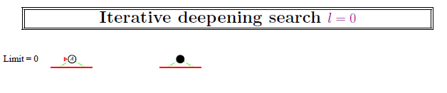

Slide 17
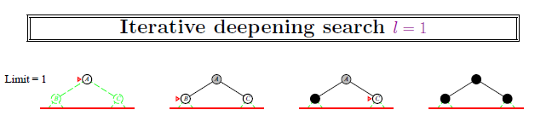

Slide 18
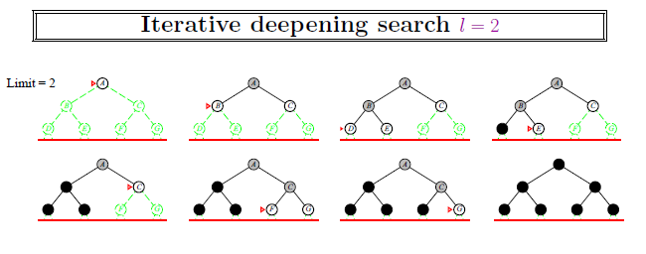

Slide 19
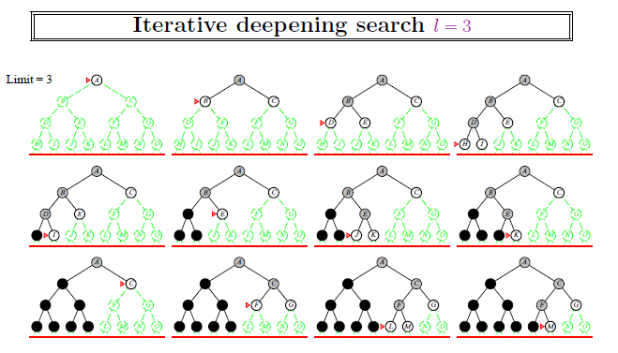

Slide 20
Remarks
Complete?? Yes
Time?? (d)b¹ + (d -1)b² + : : : + (1)b^{d} = O(b^{d})
Space?? O(b^{d})
Optimal?? Yes, if step cost = 1
Can be modified to explore uniform-cost tree
Numerical comparison for b = 10 and d = 5, solution at far right leaf:
N(IDS) = 50 + 400 + 3,000 + 20,000 + 100,000 = 123, 450
N(BFS) = 1+10 + 100 + 1, 000 + 10, 000 + 100, 000 = 1, 11,111
an iterative deepening search from depth 1 all the way down to depth d expands only about 11 % more nodes than a single breadth-first or depth-limited search to depth d, when b = 10

Slide 21
Informed Search
more information than the initial state, the operators, & the goal state is available
When this is the case, the better the information available, the more efficient the search process will be
They often depend on the use of heuristic information
A heuristic is a method that
a) might not always find the best solution
b) but is guaranteed to find a good solution in reasonable time.

Slide 22
A*
begin
g(s)=0; h(s)=0; put s in OPEN; found = false;
while OPEN not empty & not(found) do
begin
select a node from OPEN with minimum f-value(resolve ties arbitrarily, but in favor of a goal node);
remove n from OPEN & put n in CLOSED;
if n is a goal node then
found = true;
else begin
expand n generating all its immediate successors n_{i} (if any);
for each successor n_{i} of n do
begin
g = g(n) + c(n, n_{i});
if n_{i} is not already in OPEN or CLOSED then
begin
g(n_{i}) = g;
f(n_{i}) = g + h(n_{i});
put n_{i} in OPEN;
direct backward pointer from n_{i} to n;
end
else if g(n_{i}) > g then
begin
g(n_{i}) = g; f(n_{i}) = g+h(n_{i});
redirect backward pointer from n_{i} to n;
if ni is in CLOSED then
remove it from CLOSED & put n_{i} in OPEN;
end
end
end
end
If (found) then output f(n) & solution path by tracing back through pointers;
Else output failure message;
end

Slide 23
A* Example (I)
S
2 3
m1⁽⁴⁾ m2⁽⁵⁾
3 m3⁽⁰⁾ 1
4
1 2 1
m4⁽⁵⁾ m5⁽³⁾
1 1 3
m6 ⁽²⁾ r
Solution Path: S m2 m5 r, cost = 7
Note: This is not the best solution
steps | S | m1 | m2 | m3 | m4 | m5 | m6 | r
1 | 0+0
2 | 0+0 | 2+4 | 3+5
3 |  | 2+4 | 3+5 | 5+0 | 6+5
4 |  |  | 3+5 | 5+0 | 6+5 | 7+3
5 |  |  | 3+5 | 4+0 | 6+5 | 4+3
6 |  |  |  | 4+0 | 5+5 | 4+3
7 |  |  |  |  | 5+5 | 4+3 |  | 7+0
8 |  |  |  |  |  |  |  | 7+0

Slide 24
A* Example (II)
S
m1⁽⁸⁾ 1 2 m2⁽⁸⁾
3 4 n2⁽⁵⁾ 2 1 3
n1⁽⁷⁾ n3⁽⁷⁾ n4⁽⁶⁾
3 1
r1 2
r2
Solution Path: S m2 n2 r1, Cost = 7
Note: Still not the best solution
steps | S | m1 | m2 | n1 | n2 | n3 | n4 | r1 | r2
1 | 0+0
2 | 0+0 | 1+8 | 2+8
3 |  | 1+8 | 2+8 | 4+7 | 5+5
4 |  |  | 2+8 | 4+7 | 4+5 | 3+7 | 5+6
5 |  |  |  | 4+7 | 4+5 | 3+7 | 5+6 | 7+0
6 |  |  |  |  |  |  |  | 7+0

Slide 25
A* Example (III)
S
m1⁽⁶⁾ 4 2
n2⁽³⁾ m2⁽²⁾
3 4 2 1 3
n1⁽⁷⁾ n3⁽⁷⁾ n4⁽¹⁾
3
r1 1 2
r2
Solution Path: S m2 n4 r1, Cost = 6
steps | S | m1 | m2 | n1 | n2 | n3 | n4 | r1 | r2
1 | 0+0
2 | 0+0 | 1+6 | 2+2
3 |  | 1+6 | 2+2 |  | 4+3 | 3+7 | 5+1
4 |  | 1+6 |  |  | 4+3 | 3+7 | 5+1 | 6+0 | 7+0
5 |  | 1+6 |  |  | 4+3 | 3+7 |  | 6+0 | 7+0
6

Slide 26
Heuristic Estimate
Non-negative heuristic estimate h(n) is associated with each node n in the graph where h(n) is the estimate of the cost of a minimum cost path from n to a goal node
f(n) = g(n) + h(n), where f(n) gives an estimate of the cost of a minimal cost path from s to a goal node, which is constrained to pass through n, where as
g(n): cost of currently known best path from s to n
g*(n): cost of best path from s to n such that g*(n)≤g(n)
f(s): cost of the optimal solution path
h*(n) is the actual cost of a minimal cost path from n to a goal node. It is infinite if no path exists
f*(n) = g*(n) + h*(n) is the actual cost of a minimal cost path from the start node to a goal node which is constrained to pass through n, such that f*(n) ≥ f(s)

Slide 27
Remarks
If h = 0 for all nodes then A* reduces to Uniform Cost method & the optimal solution is guaranteed
A heuristic h is admissible if for each node n belonging to the graph 0 ≤ h(n) ≤ h*(n). Otherwise a heuristic is called as inadmissible
Algorithm A* finds an optimal solution path if the heuristic estimates are admissible, i.e., h(n) never overestimates the cost to reach the goal
A* never stores entire explicit graph. That’s why size of memory requirement is appreciably less in contrast to DFS
A node may be expanded more than once by A*, i.e., there is a chance of expanding more nodes in A* than Uniform Cost method

Slide 28
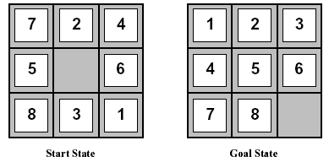
Heuristic Functions
Let’s consider the heuristics for the 8-puzzle problem, one of the earliest heuristic search problems
The two commonly used heuristic functions are:
h1 = the number of misplaced tiles. For the above figure, the start state would have h1=6. h1 is admissible heuristic, because it is clear that any tile that is out of place must be moved at least once.
h2 = the sum of the distances of the tiles from their goal positions. Because tiles can’t move along diagonals, the distance is the sum of the horizontal & vertical distances. This is sometimes called the city block distance or Manhattan distance. For the above figure, the start state gives a Manhattan distance of h2 = 4+0+3+3+1+0+2+1 = 14. h2 is also admissible, because all any move can do is to move one tile one step closer to the goal
It is easy to see from the definitions of the two heuristics that, for any node n, h2(n) ≥ h1(n), i.e., h2 dominates h1
It is always better to use a heuristic function with higher values, provided it does not overestimate & that the computation time for the heuristic is not too large

Slide 29
Important Results on A*
Consistent heuristic: for any node n and one of its children n’,
h(n) ≤ c(n, n’) + h(n’) & for any goal node G, h(G) = 0
a) If h is consistent, then prove that h(n) ≤ c(n, n’) + h(n’) is applicable for any descendant n’ of n.
Proof: Let n’’ be a grandchild of n by way of a child n’.
Then we have h(n) ≤ c(n, n’) + h(n’) (by def. of consistency)
also h(n’) ≤ c(n’, n’’) + h(n’’) (same reason)
so from (1), h(n) ≤ c(n, n’) + c(n’, n’’) + h(n’’) ≤ c(n, n’’) + h(n’’) (c(n, n’) + c(n’, n’’) = c(n, n’’) as n’’ is discovered by way of n’)
Thus the inequality holds for a grandchild n’’ of n as well as for a direct child n’ of n. By a similar argument, we can extend this to any descendant of n.

Slide 30
Important Results on A* contd..
b) If A* uses a consistent heuristic, then f(n) is non-decreasing along any path
Proof: We know that f(n) = g(n) + h(n) --------------- (1)
Since A* uses a consistent heuristic, so h(n) ≤ c(n, n’) + h(n’), where n’ is a successor of n by some action a.
So, from (1) we have, f(n) ≤ g(n) + c(n, n’) + h(n’) ≤ g(n’) + h(n’) ≤ f(n’)
(Since g(n) + c(n, n’) = g(n’) as n’ is a successor of n)
Thus we can say that a node’s f is never less than it’s parent’s f, so f is non-decreasing along any path
c) If h is consistent, then h is admissible also
Proof: Since h is consistent heuristic, so h(n) ≤ c(n, n’) + h(n’) ---------- (1)
Now, for any node n, consider the best path from it to any goal node. Its cost is h*(n), which an admissible heuristic must not overestimate. For the consistent heuristic, n’ can be any descendant of n. Consider n’ is G, where G is the best reachable goal node.
So from (1) we get, h(n)≤ c(n, G) + h(G)
Since h(G) = 0, so we have h(n)≤ c(n, G);
But c(n, G) is basically h*(n)
So h(n) ≤ h*(n) which is the definition of admissible heuristic. Hence the proof.

Slide 31
Important Results on A* contd..
Prove that the heuristic ‘sum of manhattan distances’ for the 8-puzzle problem is an admissible heuristic
Proof: Let the sum of manhattan distances be denoted by totdist. We have to prove that totdist ≤ h* ∀ positions
this relation can be proved by the following argument:
if we relaxed the problem by allowing the tiles to climb on top of each other, then each tile could travel to its home square along a trajectory whose length is exactly the manhattan distance .
so the optimal solution in the relaxed puzzle would be exactly of length totdist.
In the original problem, however, there is interaction between the tiles and they are in each other’s way. This can prevent the tiles from moving along the shortest trajectories, which ensures our optimal solution’s length be equal to greater than totdist, i.e. h*≥ totdist.

